Slide 1

DATABASE
TECHNOLOGIES
Relational model, Storage formats
and Indexing
Suresh Jamadagni
Department of Computer Science
and Engineering

Slide 2

DATABASE TECHNOLOGIES
Relational model, Storage formats and Indexing
Suresh Jamadagni
Department of Computer Science and Engineering

Slide 3
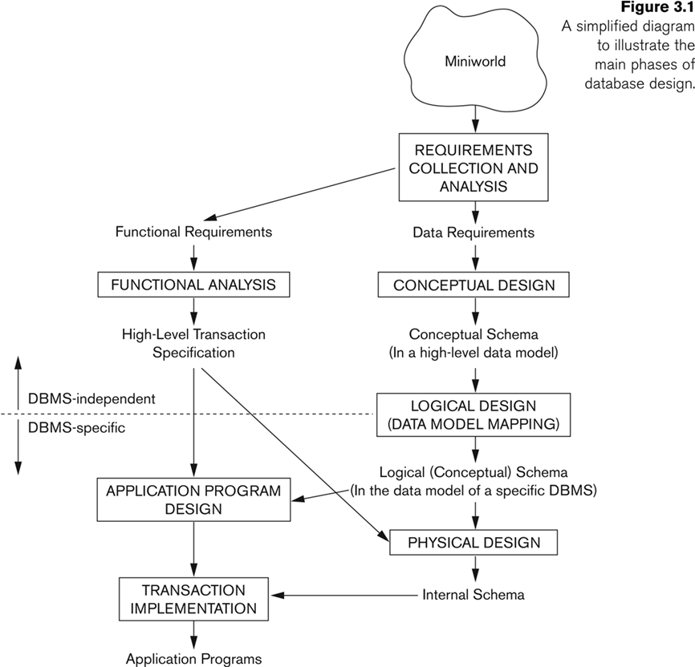
DATABASE TECHNOLOGIES
Relational Model – Database Design

Slide 4
DATABASE TECHNOLOGIES
Relational Model – Database Design – Conceptual Model
ER Diagram
Entity is a basic concept for the ER model. Entities are specific things or objects in the mini-world that are represented in the database.
Attributes are properties used to describe an entity.
A specific entity will have a value for each of its attributes.
Each attribute has a data type associated with it – e.g. integer, string, date, enumerated type
A value set (Domain) specifies the set of values associated with an attribute
A relationship relates two or more distinct entities with a specific meaning.
The degree of a relationship type is the number of participating entity types

Slide 5
DATABASE TECHNOLOGIES
Relational Model – Database Design
Requirements:
An Employee works in a department.
A Department can have many Employees. One of the employees manages the department.
An employee may have many dependents
A department controls many projects
An employee can work on many projects
Time spent by the employee on each project needs to be captured.

Slide 6
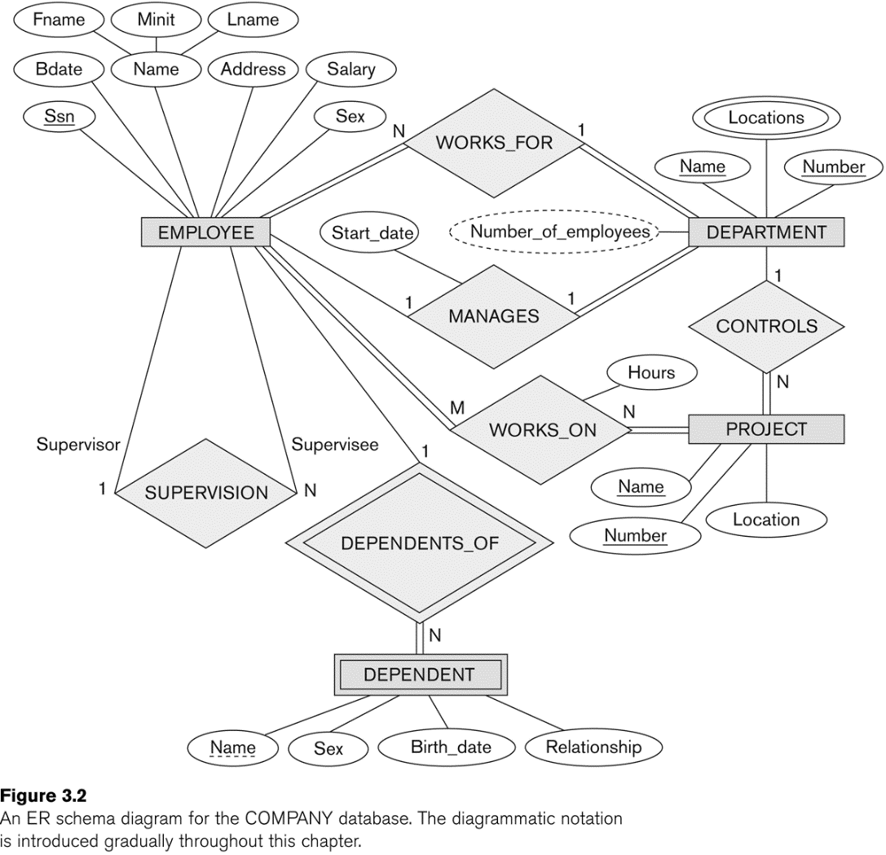
DATABASE TECHNOLOGIES
Relational Model – ER Diagram example

Slide 7
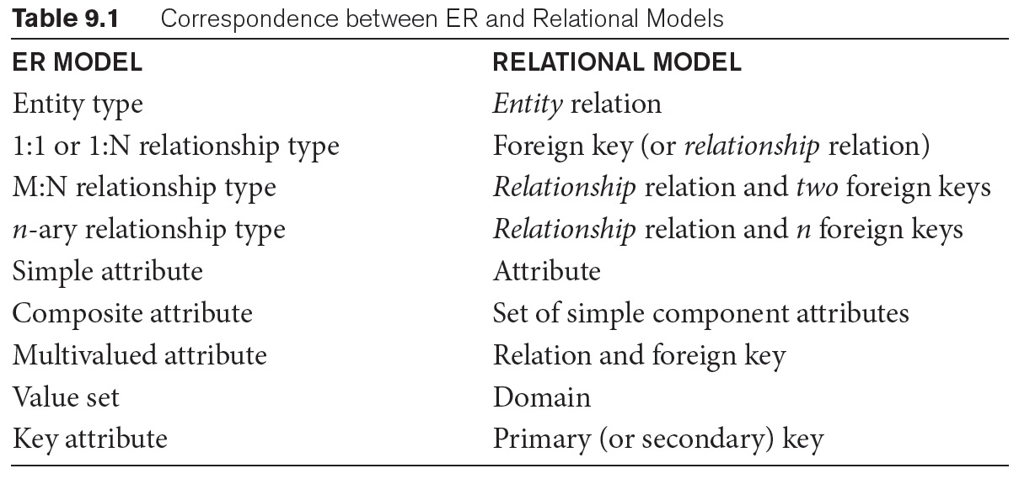
DATABASE TECHNOLOGIES
Transforming Conceptual Model to Relational Model

Slide 8
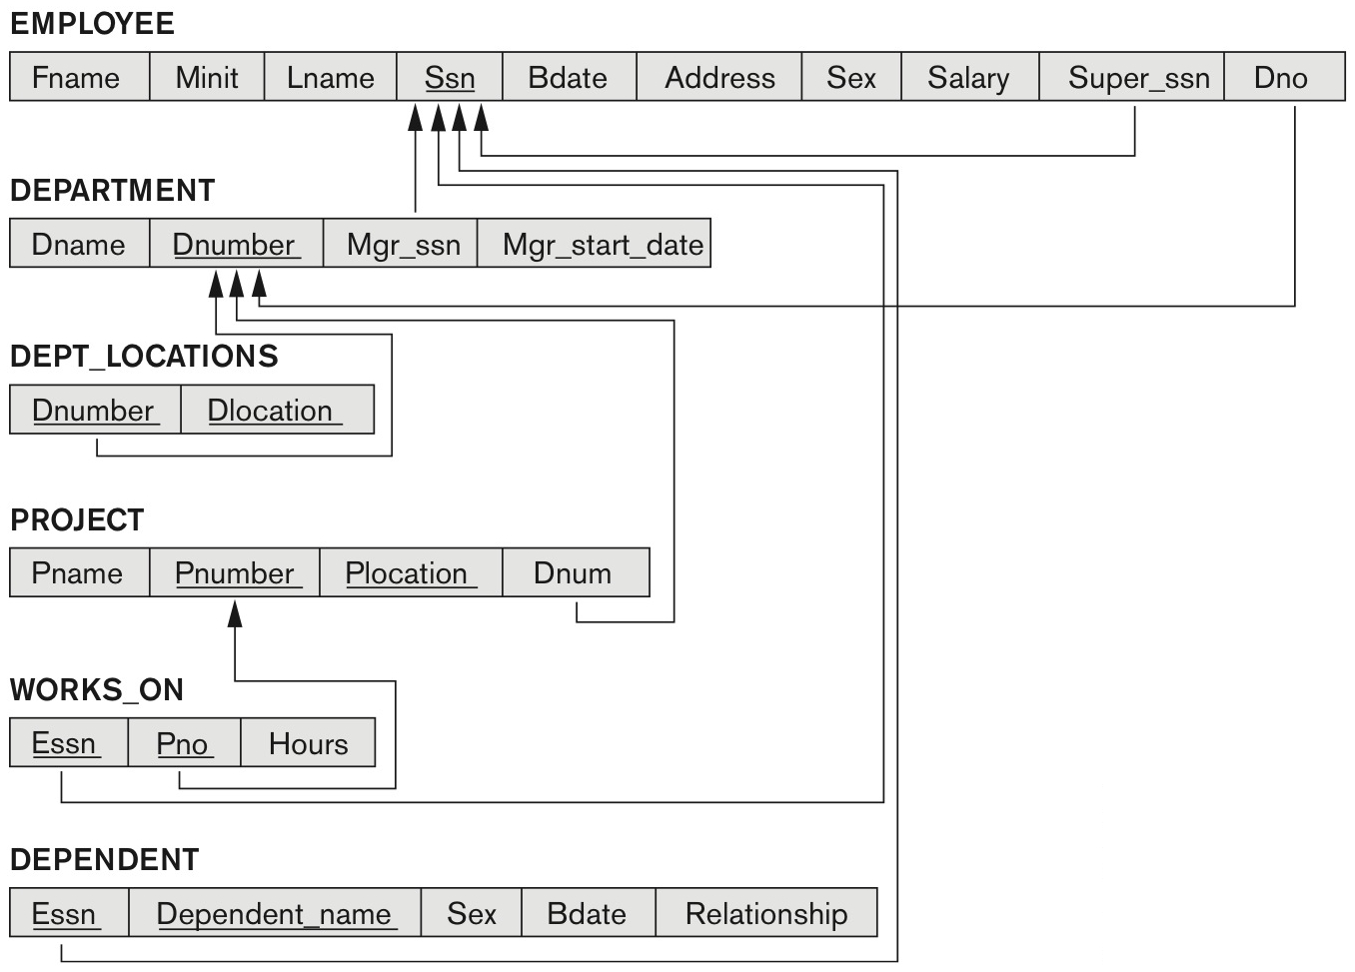
DATABASE TECHNOLOGIES
Transforming Conceptual Model to Relational Model Example

Slide 9
DATABASE TECHNOLOGIES
Relational Model – Relational Algebra
Relational algebra is the basic set of operations for the relational model
Relational algebra consists of several groups of operations
Unary Relational Operations
SELECT (symbol: σ (sigma))
PROJECT (symbol: π (pi))
RENAME (symbol: ρ (rho))
Relational Algebra Operations From Set Theory
UNION ( ∪ ), INTERSECTION ( ∩ ), DIFFERENCE (or MINUS, – )
CARTESIAN PRODUCT ( x )
Binary Relational Operations
JOIN (several variations of JOIN exist)
DIVISION
Additional Relational Operations
OUTER JOINS, OUTER UNION
AGGREGATE FUNCTIONS (SUM, COUNT, AVG, MIN, MAX)
_{DNO} ℱ_{COUNT SSN, AVERAGE Salary} (EMPLOYEE)

Slide 10
DATABASE TECHNOLOGIES
Relational Model – Constraints
Relational Model has 3 basic constraint types that are supported in SQL:
Key constraint: A primary key value cannot be duplicated
Entity Integrity Constraint: A primary key value cannot be null
Referential integrity constraints : The “foreign key “ must have a value that is already present as a primary key or may be null.

Slide 11
DATABASE TECHNOLOGIES
Relational Model – Constraints Example
Create table Company.Department (
Dname varchar(50) not null,
Dnumber smallint not null,
Mgr_ssn varchar(9) null CHECK (Mgr_ssn like replicate('[0-9]',9)),
Mgr_start_date date not null CHECK (Mgr_start_date < getdate()),
constraint Department_PK primary key (Dnumber),
constraint Dept_Mgr_FK foreign key (Mgr_ssn) references Company.Employee(SSN) on delete set null);

Slide 12
THANK YOU
Suresh Jamadagni
Department of Computer Science and Engineering
sureshjamadagni@pes.edu

